Slide 1

Introduction to Multiple Linear Regression
A foundational supervised learning algorithm that predicts continuous outputs from multiple input variables — extending Simple Linear Regression into the real world.
What It Is
Why We Need It
A model that uses multiple independent variables to predict one continuous output
Real-world outcomes rarely depend on just one factor — multiple inputs give richer predictions
Real-World Example
House Size + Bedrooms + Location → House Price

Slide 2
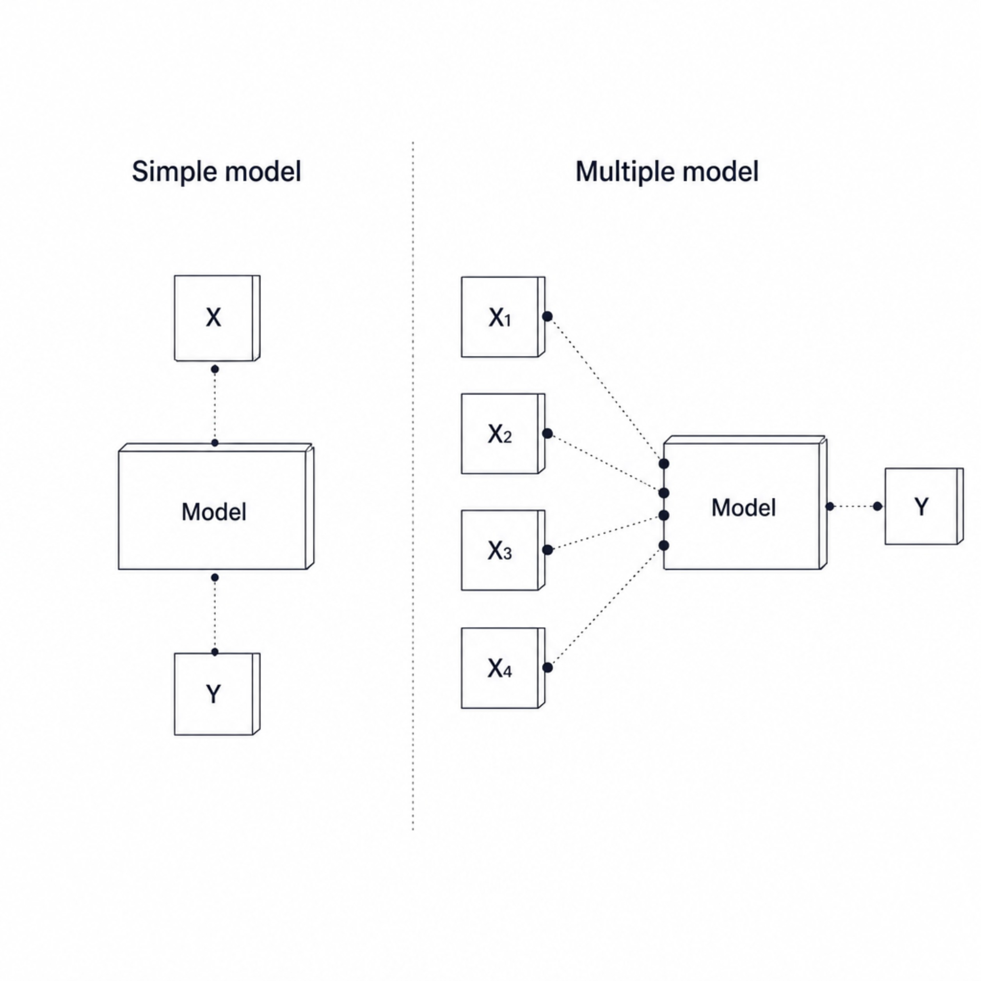
From Simple to Multiple Linear Regression
Simple Linear Regression
y = mx + b
Uses one independent variable to make a prediction.
Example: Years of Experience → Salary
Multiple Linear Regression
y = b₀ + b₁x₁ + b₂x₂ + ... + bₙxₙ
Uses multiple independent variables simultaneously.
Example: Age + Experience + Education → Salary
Instead of a single input, Multiple Linear Regression combines many features to produce a more accurate, real-world prediction.

Slide 3

The Multiple Linear Regression Formula
y = b₀ + b₁x₁ + b₂x₂ + ... + bₙxₙ
y — Predicted Output
b₀ — Intercept / Bias
b₁, b₂, ..., bₙ — Coefficients
The dependent variable the model is trying to estimate (e.g., salary, house price)
The baseline prediction when all input features equal zero
Each coefficient measures how strongly its feature influences the prediction, holding all other features constant
x₁, x₂, ..., xₙ — Input Features
n — Number of Features
The independent variables fed into the model (e.g., experience, education level, age)
The total count of independent input variables used in the model

Slide 4
Mathematical Example: Salary Calculation
Our Trained Model
Step-by-Step Calculation
Salary = 20,000 + 5,000(5) + 3,000(2)
Salary = 20,000 + 25,000 + 6,000
Salary = 20,000 + 5,000(Experience) + 3,000(Education Level)
Known Values
Salary = ₹51,000
Variable
Symbol
Value
Intercept
b₀
20,000
The model combines all inputs into one continuous prediction.
Experience Coeff.
b₁
5,000
Education Coeff.
b₂
3,000
Experience
x₁
5 years
Education Level
x₂
2

Slide 5




Understanding the Coefficients
Using: Salary = 20,000 + 5,000(Experience) + 3,000(Education Level)
Intercept — b₀ = 20,000
Experience Coefficient — b₁ = 5,000
Education Coefficient — b₂ = 3,000
The baseline salary predicted when all input variables are zero. It anchors the entire regression equation.
For every additional year of experience, predicted salary increases by ₹5,000 — while holding education level constant.
For every one-unit increase in education level, predicted salary increases by ₹3,000 — while holding experience constant.
Each coefficient isolates the effect of one feature while assuming all other features remain unchanged — this is the "ceteris paribus" principle in regression.

Slide 6





Real-World Example: House Price Prediction
Price = b₀ + b₁(Size) + b₂(Bedrooms) + b₃(Age) + b₄(Distance)
🏠 House Size
Square footage — larger homes command higher prices
🛏 Bedrooms
Number of bedrooms — more rooms, higher value
📅 Age of House
Older homes may depreciate — negative coefficient expected
📍 Distance
Distance from city center — farther often means lower price
💰 Predicted Price
The model combines all features into one continuous output
Using multiple variables provides far more predictive power than relying on house size alone.

Slide 7

How the Model Learns the Coefficients
The Learning Process
We do not manually choose b₀, b₁, b₂ ... The machine learning algorithm learns them from training data.
Residual / Error
Error = Actual − Predicted
The gap between what the model predicts and the true observed value is called the residual.
Training Data
OLS Algorithm
Minimize Error
Learned Coefficients
Ordinary Least Squares (OLS)
Linear Regression finds the coefficients that minimize the total squared error across all training examples — making predictions as close to actual values as possible.
The algorithm iterates over training data, comparing actual vs. predicted values, and adjusts coefficients to shrink residual error lines.

Slide 8
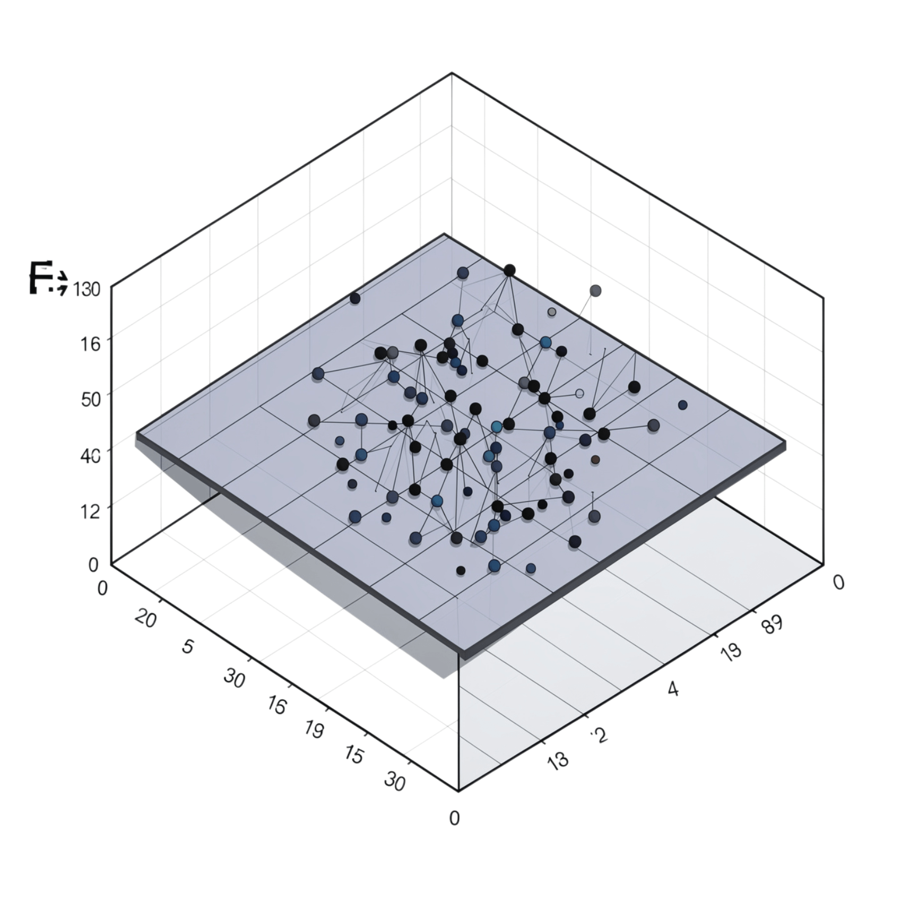
Multiple Regression Visualization
Geometry helps build intuition for what the model is actually doing in feature space.
Simple Linear Regression
Multiple Regression (2 features)
Multiple Regression (n features)
1 feature → fits a line through 2D data points
2 features → fits a plane through 3D data points
n features → fits a hyperplane in n+1 dimensional space
3D Example: House Price
X₁ axis = House Size
X₂ axis = Number of Bedrooms
Y axis = House Price
Each data point floats in 3D space. The regression algorithm fits a flat plane that passes as close as possible to all data points — minimizing the vertical distance (residuals) from each point to the plane.
With more than 2 features, the plane extends into higher dimensions — impossible to visualize, but mathematically identical.

Slide 9

Simple vs. Multiple Linear Regression
Feature
Simple Linear Regression
Multiple Linear Regression
Number of Inputs
1
2 or more
Formula
y = mx + b
y = b₀ + b₁x₁ + ... + bₙxₙ
Example
Experience → Salary
Experience + Education → Salary
Visualization
Line (2D)
Plane / Hyperplane
Complexity
Lower
Higher
More features ≠ better model. Feature quality, data quality, multicollinearity, overfitting, and proper model evaluation all matter significantly.
Use Simple Linear Regression when one input is sufficient. Use Multiple Linear Regression when multiple independent variables each contribute meaningful predictive information.

